Slide 1
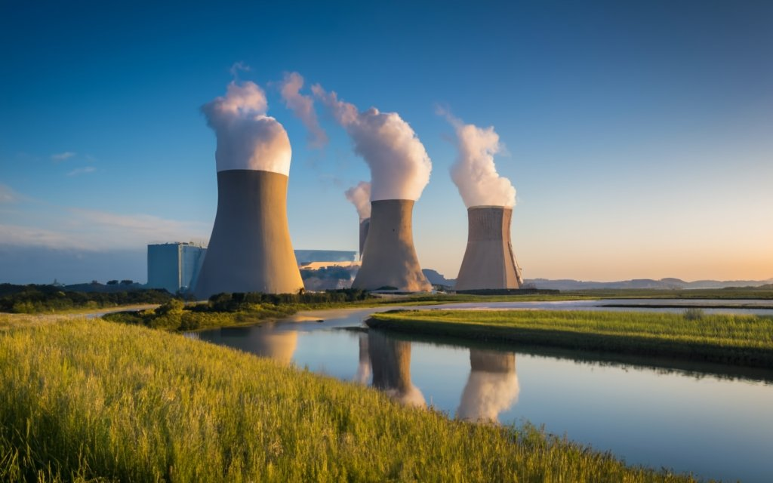
Nuclear Power Plants
An Analysis to Assess the Growth Opportunity for Nuclear Power Plants
Ramon Tomzer
9/8/23

Slide 2
Outline
Executive Summary
Introduction
Methodology
Results
Conclusion
Appendix

Slide 3
Executive Summary
Summary of Methodologies
Data Aggregation from various sites such as Kaggle, Github, Worldbank, United Nations, US Census, and International Energy Agency
Data Wrangling using Pandas
Exploratory Data Analysis and visualizations using Matplotlib and Folium
Bar charts, Heatmaps, Map Markers
Summary of Results
The study underscores the imminent need for clean and sustainable energy solutions, particularly nuclear energy, given the global shift away from fossil fuels. While Africa remains critically underpowered, Western countries are also looking to transition to greener options. The study advocates for a focused investment in nuclear energy technologies, which have shown remarkable advancements in safety and efficiency.
Using data visualizations like heatmaps, the study pinpoints optimal locations in the U.S. for new nuclear installations. These locations were evaluated based on multiple criteria including site size, accessibility, water resources, seismic stability, air quality, population density, and security. The study also suggests that some existing decommissioned or shutdown sites could be cost-effectively refurbished or retooled for new use.
Thus, the research provides a comprehensive blueprint for future nuclear energy investments, ensuring that the U.S. not only meets its current energy demands but also sets a global example for sustainable energy solutions.

Slide 4
Introduction
Background
The project began as a comprehensive study aimed at evaluating the viability and strategic importance of nuclear energy in both domestic and international contexts. With the growing urgency to transition from fossil fuels to more sustainable energy solutions, the focus was to assess how nuclear energy could play a pivotal role in this transition. The project used a multi-pronged approach, employing data analysis and geospatial mapping. It specifically targeted identifying optimal locations for future nuclear installations in the United States, while also highlighting the underutilization of this energy source in regions like Africa. The overarching goal was to provide a data-driven, actionable roadmap for stakeholders to make informed decisions about investing in nuclear energy, considering various factors from logistical to environmental.

Slide 5
Problem Statement
To identify countries and specific locations within the United States, where there is significant opportunity for growth in nuclear power generation. This will be done by evaluating the current operational capacities against energy needs, while also considering ecological and societal factors.
Availability of Cooling Water: Existing and potential sites with abundant freshwater resources or access to the ocean.
Geological Stability: Regions with low seismic activity and minimal risk of flooding are preferable for growth opportunities.
Proximity to Population Centers: Current nuclear capacities in relation to major population centers to evaluate if they are serving the energy needs effectively.
Environmental Sensitivity: Current ecological impact and public acceptance of existing nuclear power plants.

Slide 6
Methodology

Slide 7
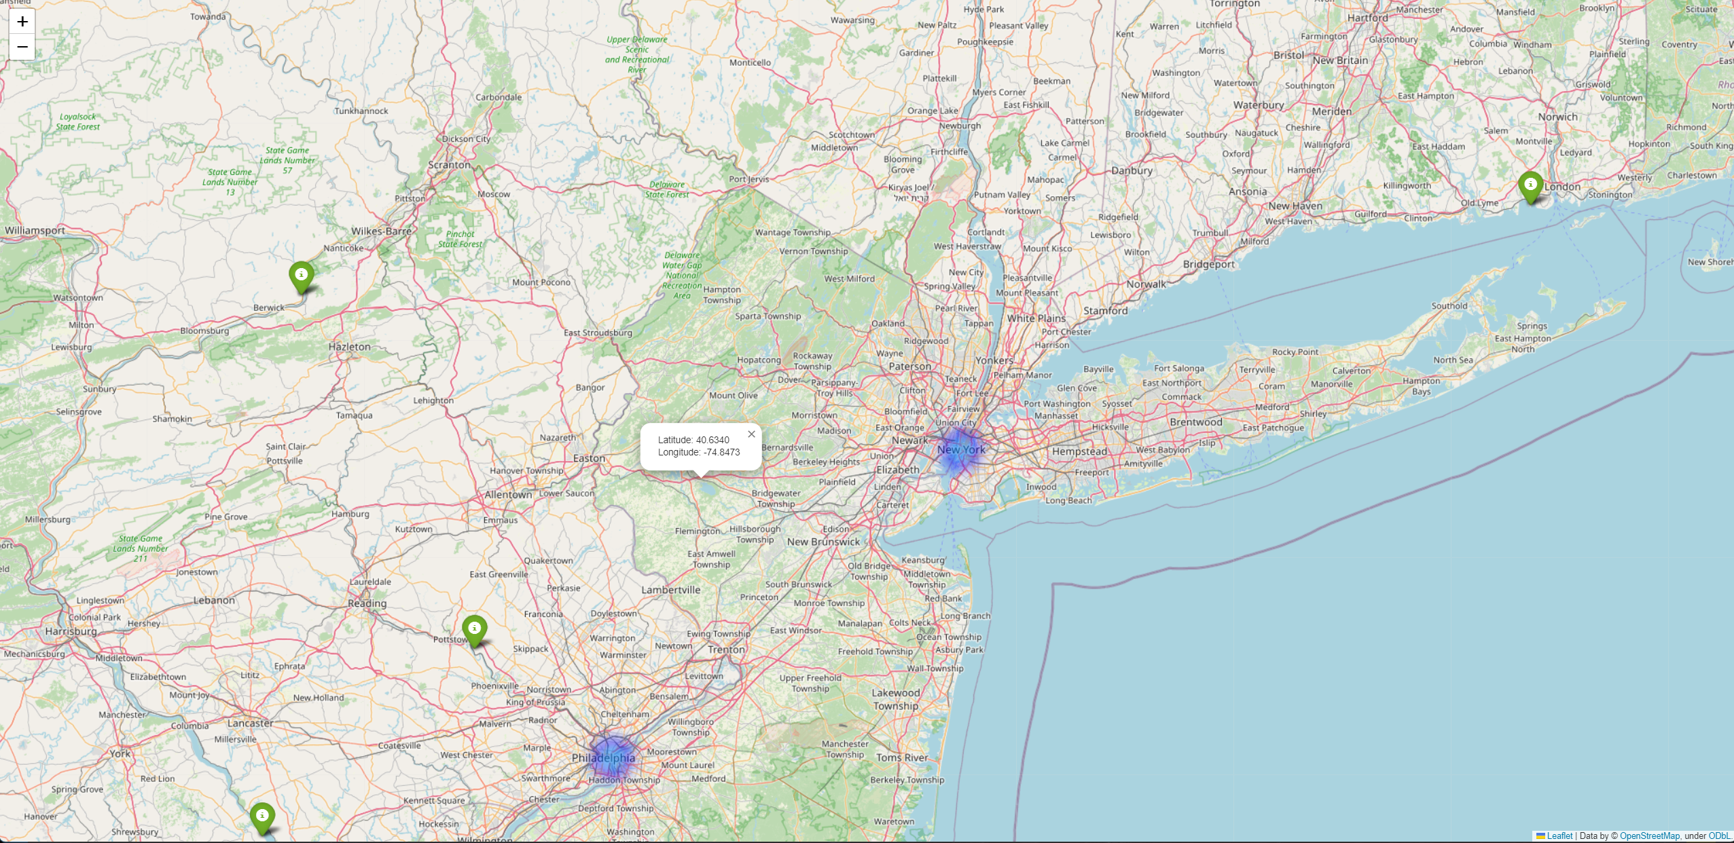
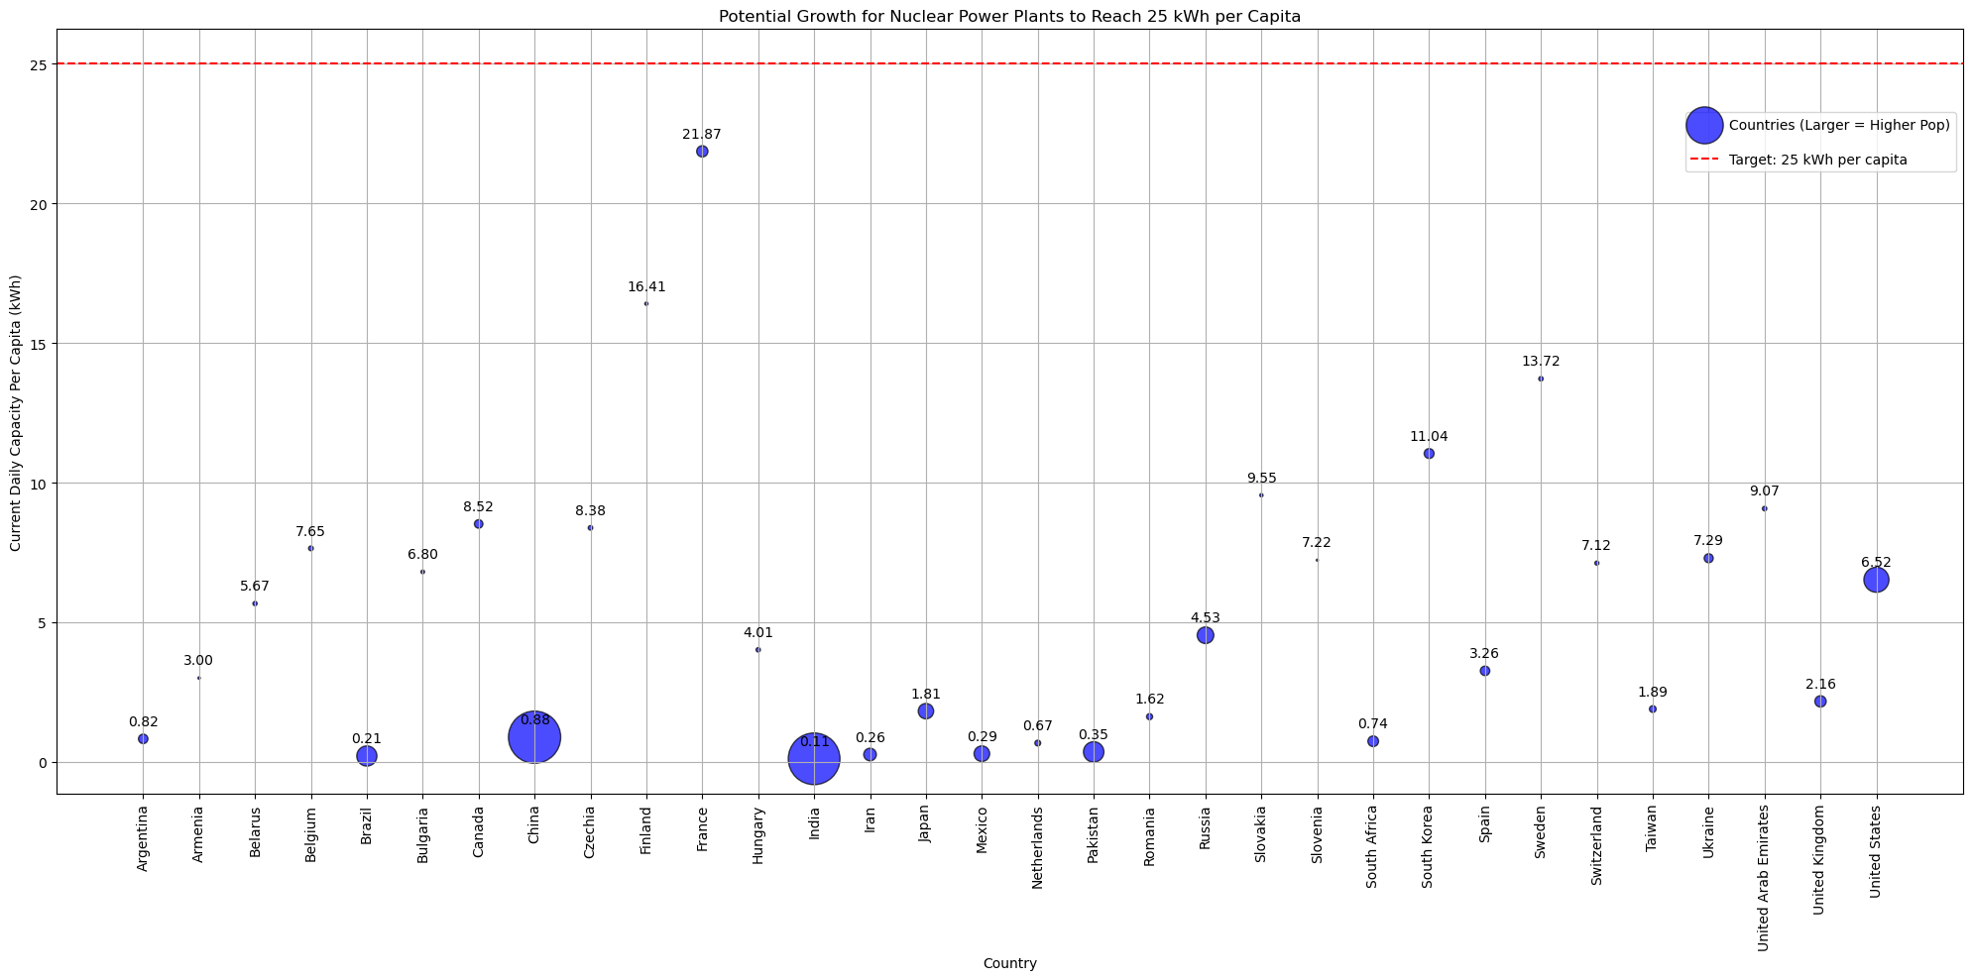
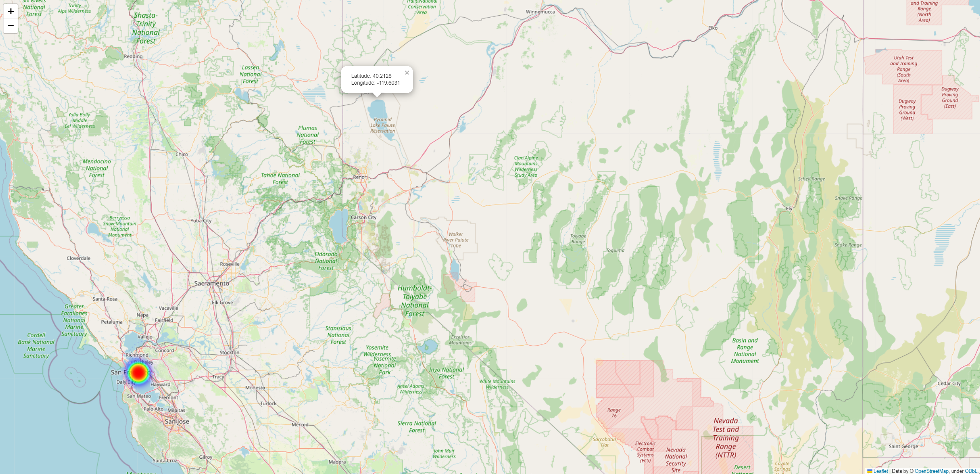
Data Collection, Cleaning and Preprocessing
Data Aggregation from various sites such as Kaggle, Github, Worldbank, United Nations, US Census, and International Energy Agency
Data Wrangling using Pandas
Exploratory Data Analysis and visualizations using Matplotlib and Folium
Bar charts, Heatmaps, Map Markers
Link to notebook on Github

Slide 8
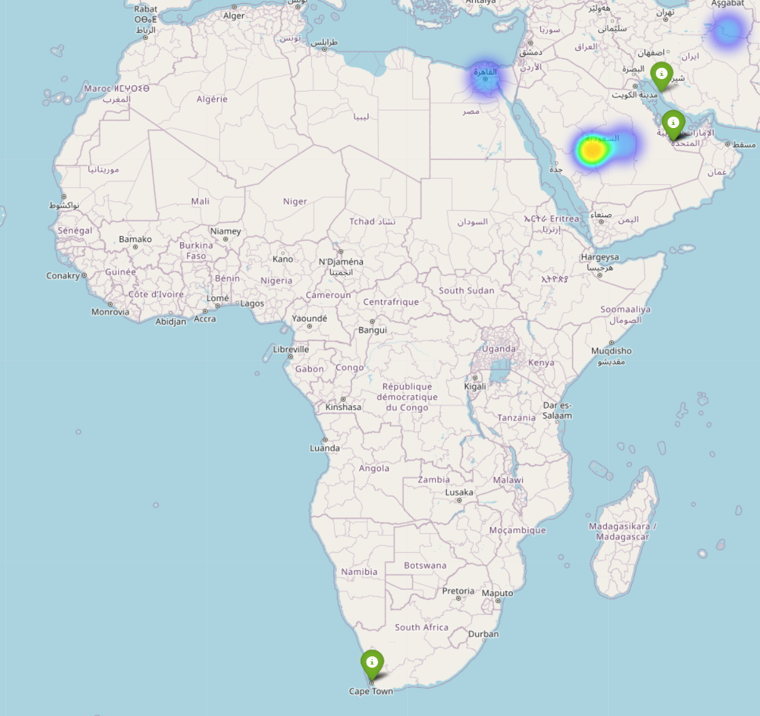
Exploratory Data Analysis
Under-energized and Underutilized
Looking at the daily energy requirements across the globe we can see that there are areas with large populations who are not getting enough clean energy, creating a market for those who can fill that demand.
In the map to the right, notice the heatmap markers, and the lack of operational nuclear power plants in proximity.
Furthermore, look at the lack of nuclear power in ALL of Africa, a continent of about 1.4 Billion people.
Code to Heatmap and Marker overlay

Slide 9

Exploratory Data Analysis
A global shortage even in ‘developed’ countries
As the demand for sustainable and eco-friendly energy solutions intensifies, the necessity for expanding nuclear power has become increasingly urgent. This presents a significant opportunity waiting to be capitalized upon by those willing to take the initiative.

Slide 10
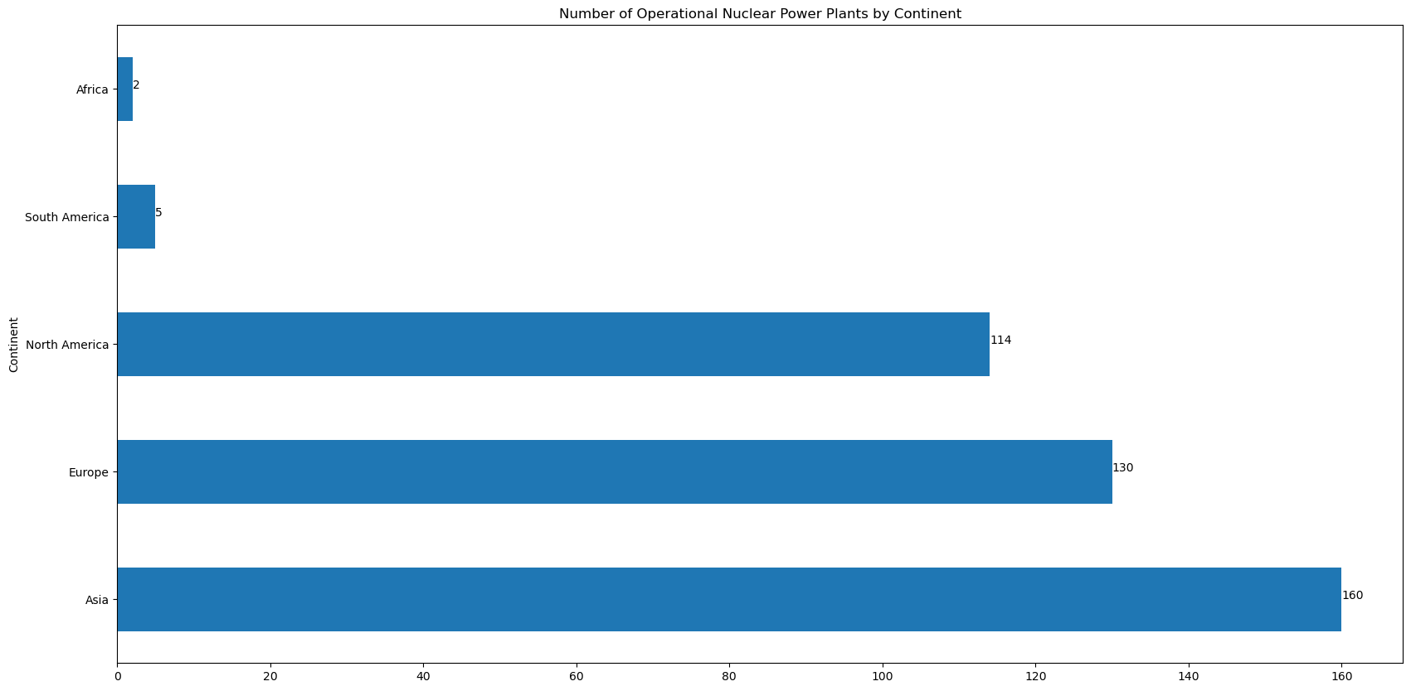
Exploratory Data Analysis
Notice that in all of Africa there are only 2 operational nuclear power plants
Only 5 in South America
Almost 2 Billion people between those two continents, representing a large missed opportunity for nuclear power

Slide 11
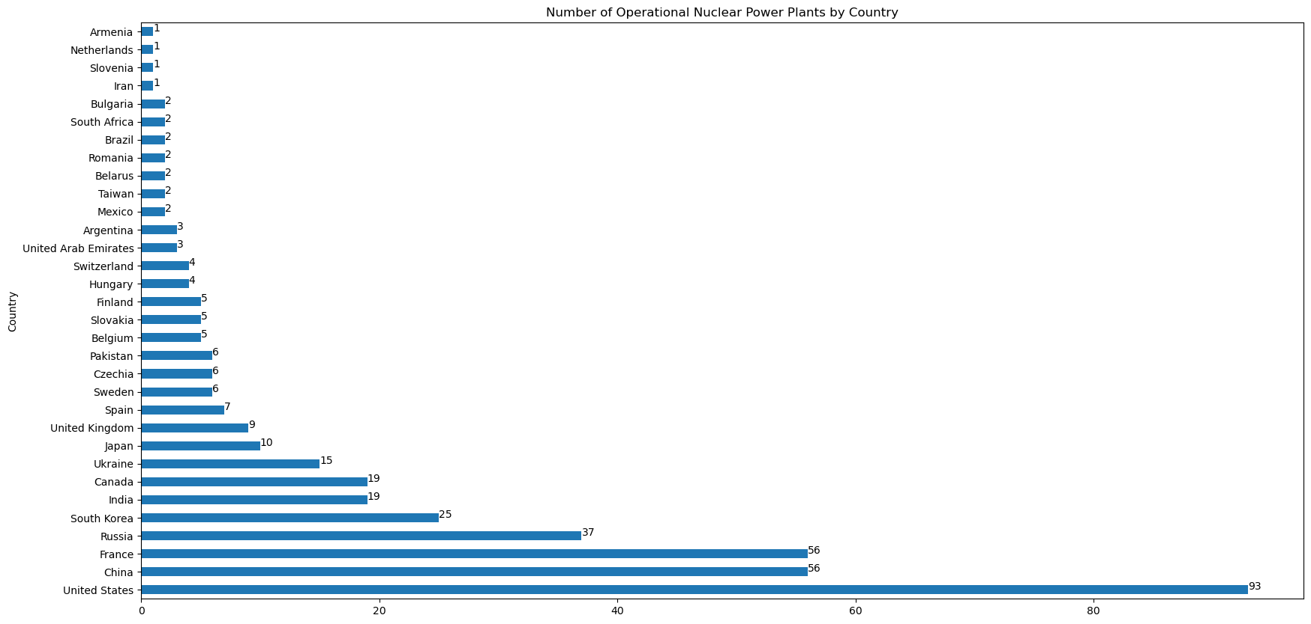
Exploratory Data Analysis
Although the United States is the country with the most operational nuclear power plants, we will see that there is still plenty of opportunities to capitalize on the need for ‘greener’ and ‘cleaner’ energy (we will dive into this more in later slides)
Although China has a significantly larger population than the United States, we can see that the US has nearly double the amount of nuclear power plants

Slide 12
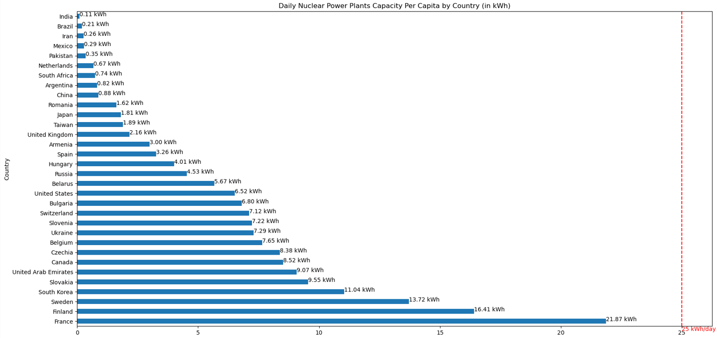
Daily nuclear capacity per capital by country
The International Energy Agency estimates that the average electricity usage in OECD (Organisation for Economic Co-operation and Development) countries (which are mostly western countries) is about 25kwh per day.
Given this figure, we can see just how much room for growth there really is in this sector, given CURRENT energy consumption

Slide 13
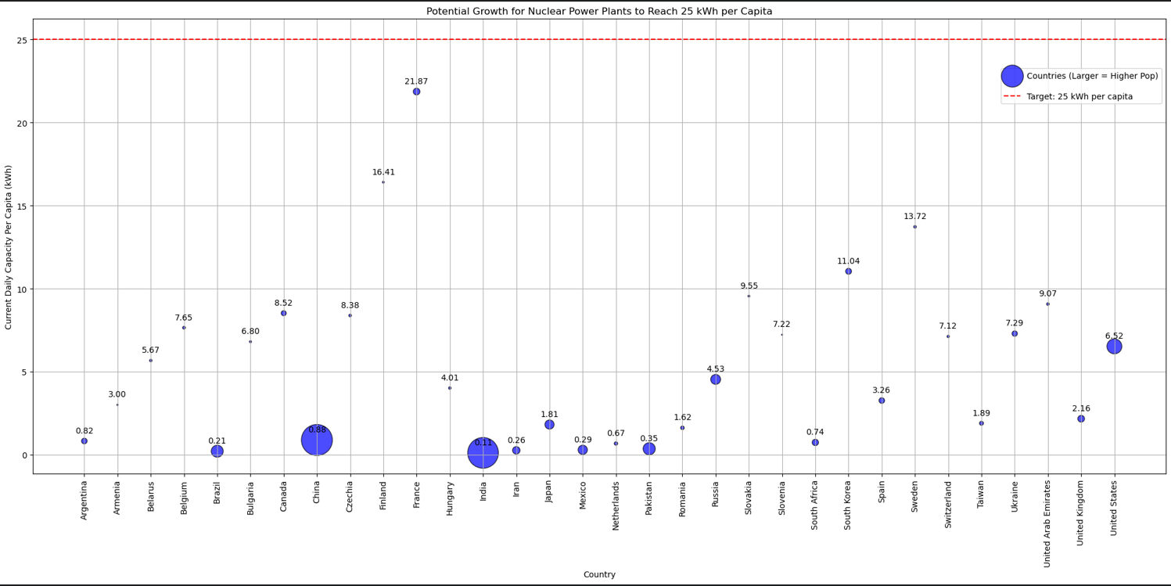
Daily nuclear capacity per capital by country
Visualized another way, we can see that the only country within spitting distance of meeting their daily energy demand per capita is France, who have the same amount of nuclear power plants as a much more populous China
Notice just how much more nuclear energy the US requires to meet that same demand threshold

Slide 14
Potential Sites for Nuclear Power Plants

Slide 15
Potential Site Considerations
Availability of Cooling Water: Existing and potential sites with abundant freshwater resources or access to the ocean.
Geological Stability: Regions with low seismic activity and minimal risk of flooding are preferable for growth opportunities.
Proximity to Population Centers: Current nuclear capacities in relation to major population centers to evaluate if they are serving the energy needs effectively.
Environmental Sensitivity: Current ecological impact and public acceptance of existing nuclear power plants.

Slide 16
Pyramid Lake, Nevada
This site has potential to help serve the Reno-Carson City area, but also export additional energy to help serve the SF-Oakland metro area
This site was chosen primarily to help the bay area but also keep in line with seismic stability

Slide 17
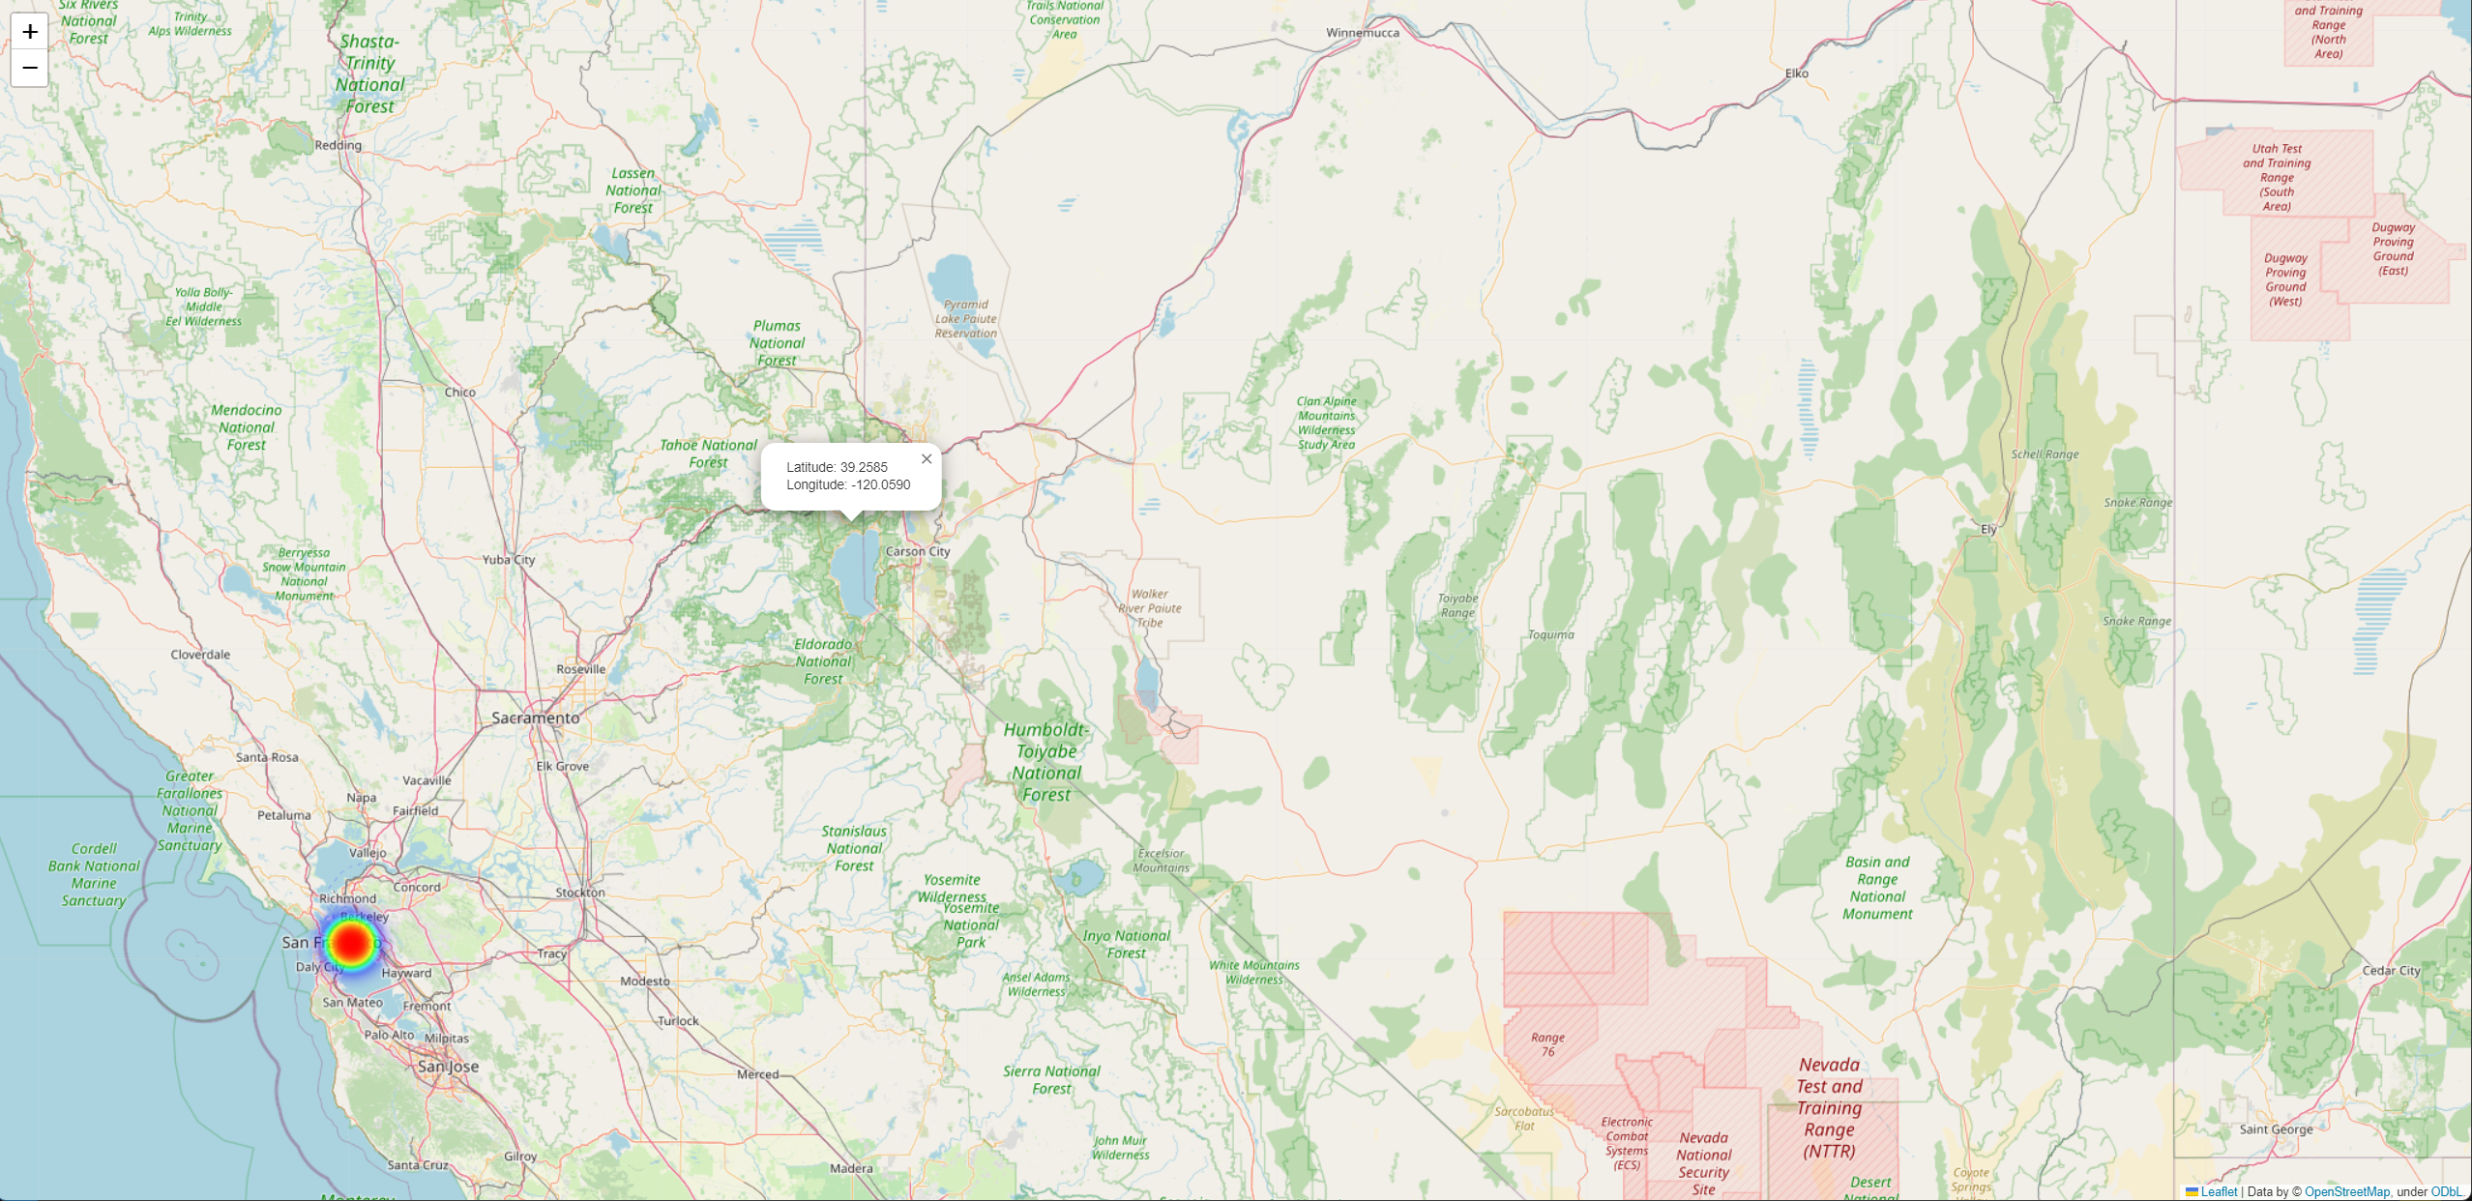
Lake Tahoe
For the same reasoning, Lake Tahoe might also be another contender to help alleviate the Bay Area energy demands, while still providing a much more seismic stable construction site
It should be noted that these first two sites are still somewhat seismically active compared to other parts of the country, but much less active, en masse, than other parts of California

Slide 18
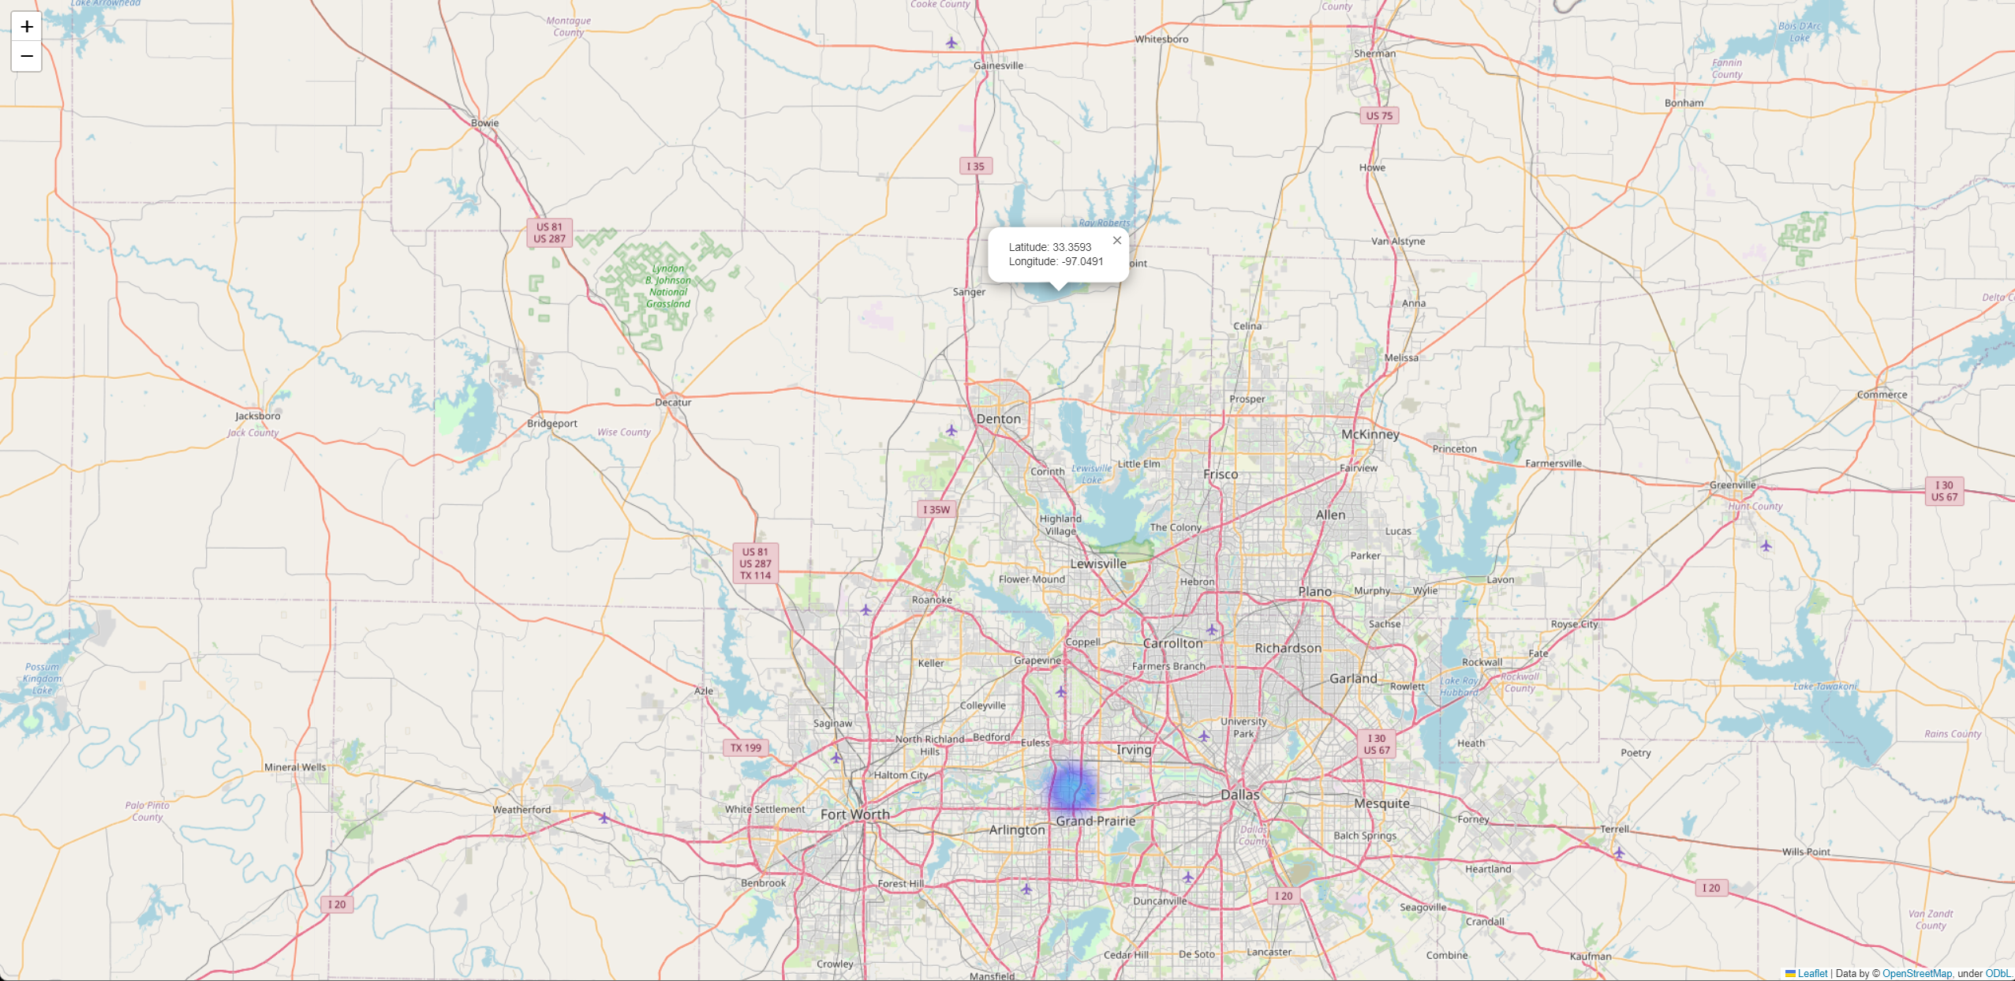
Ray Roberts Lake, TX
This site has the potential to service the Dallas-Forth Worth metro area
It is protected from gulf storms as it is inland from the coast and sits on seismically stable ground

Slide 19
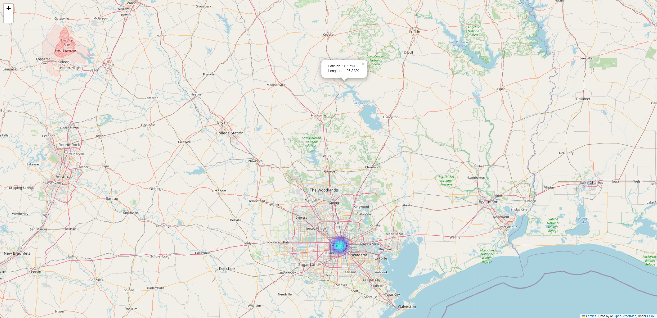
Lake Livingston, TX
For the same reasons as Ray Roberts Lake, Lake Livingston offers the same considerations to help service the Houston metro area

Slide 20
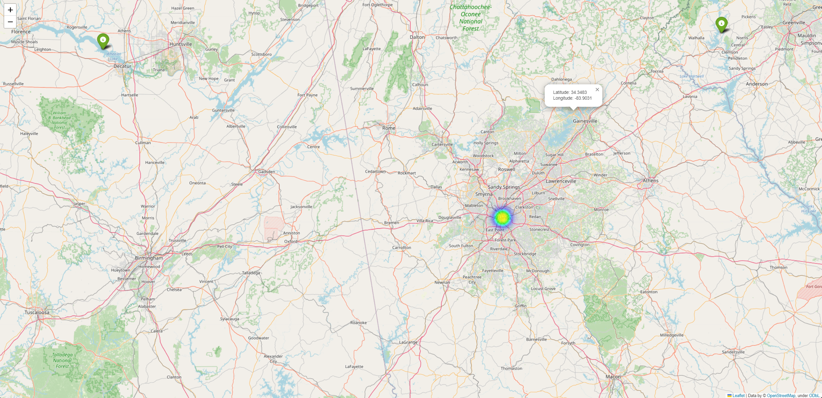
Gainesville, GA
Gainesville, GA is another potential site that could serve as a place to a nuclear power plant
Proximal to Atlanta and Lake Lanier

Slide 21
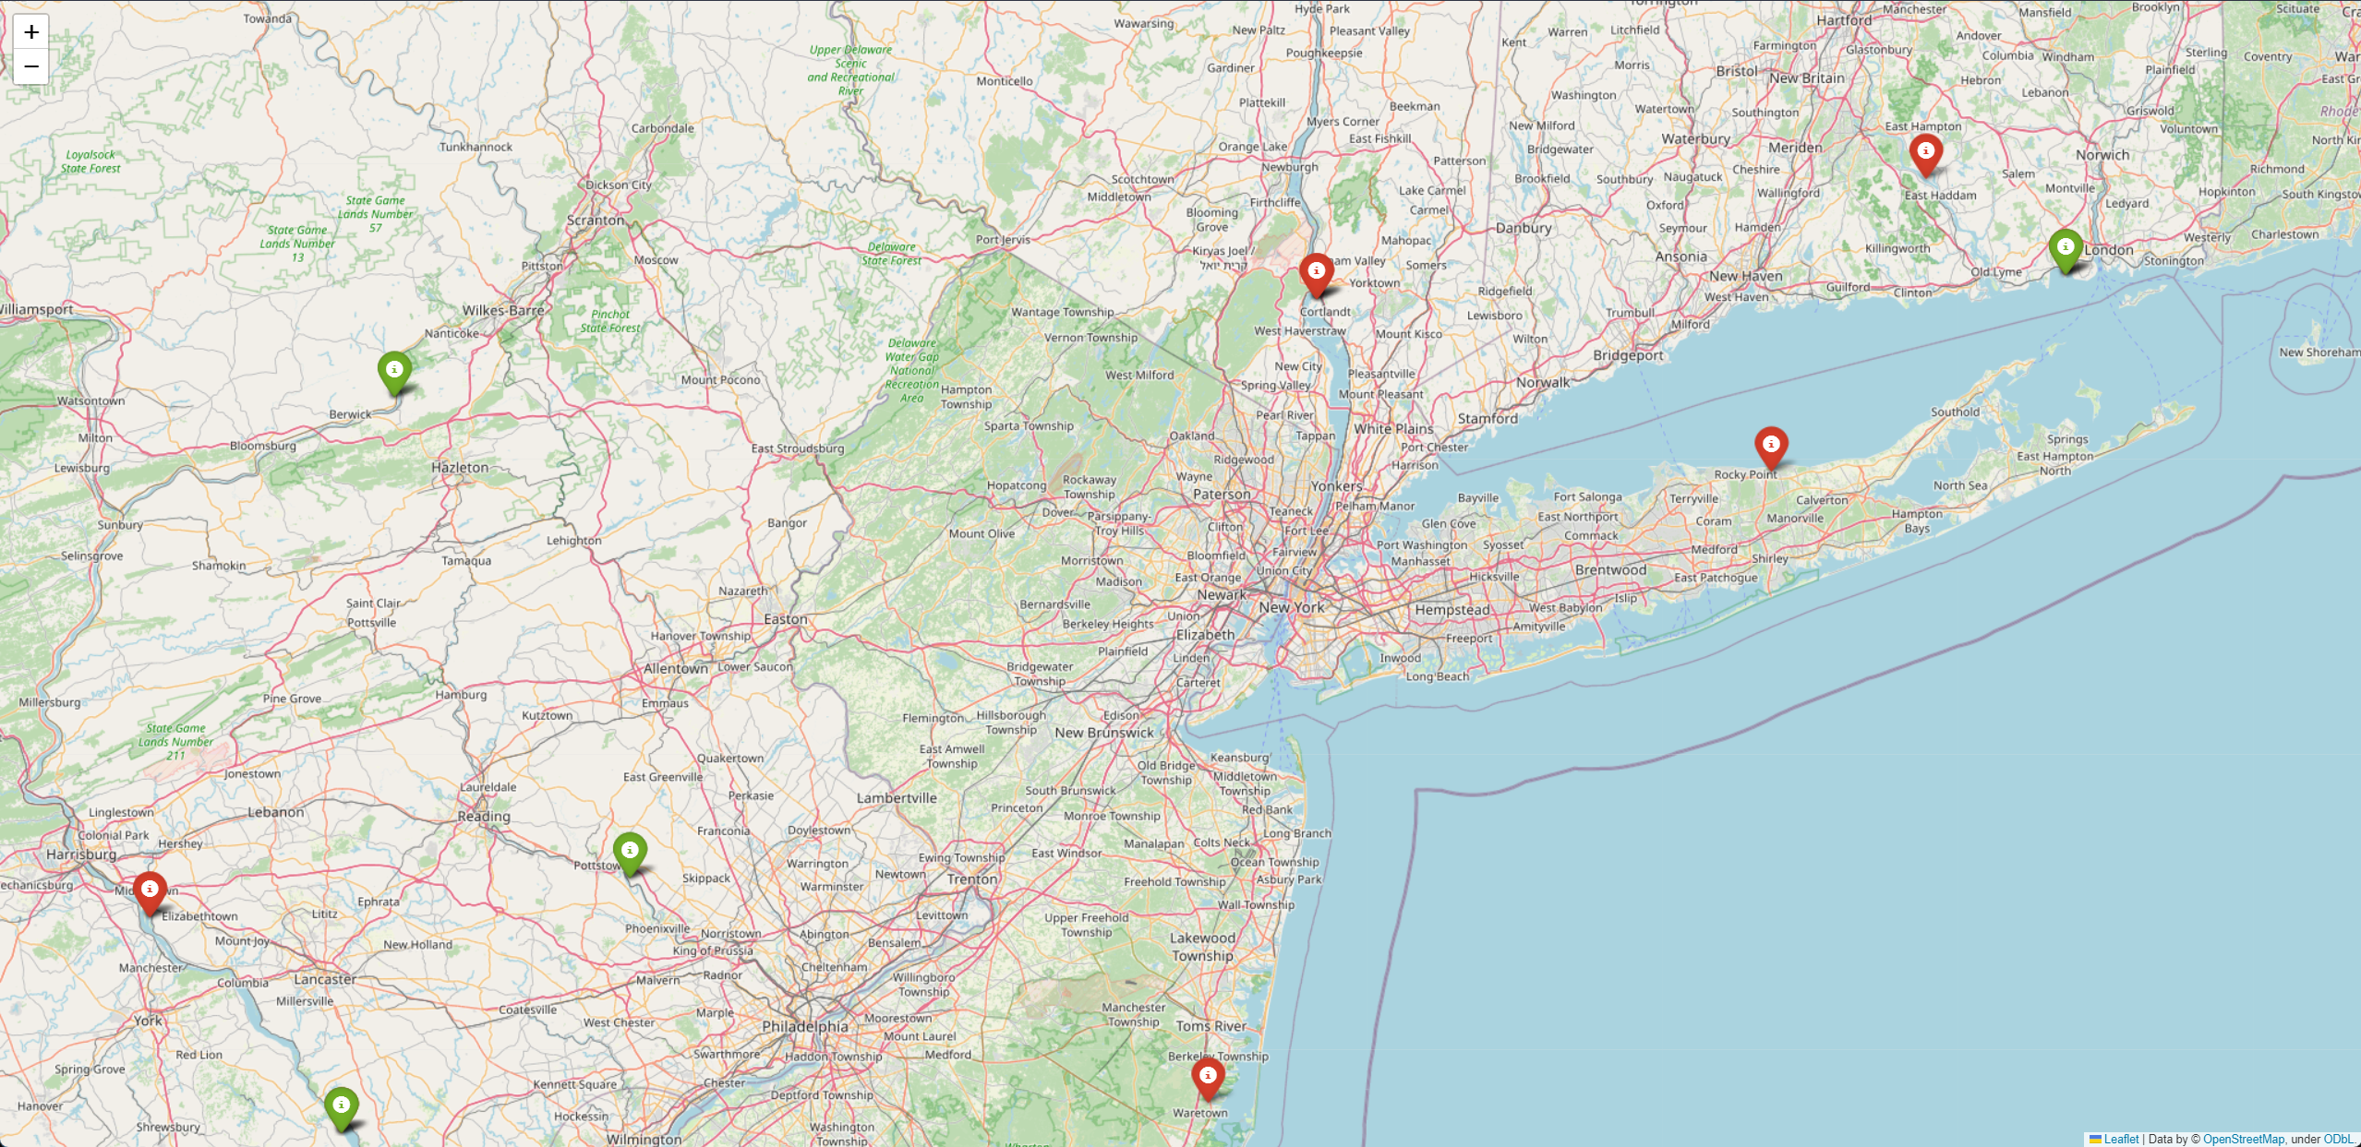
Round Valley, NJ
One caveat to mention is that this site, as well as other sites, may benefit from a refurbishing or re-tooling of current decommissioned or shutdown nuclear sites as this may be more cost responsible and have implications on ROI

Slide 22
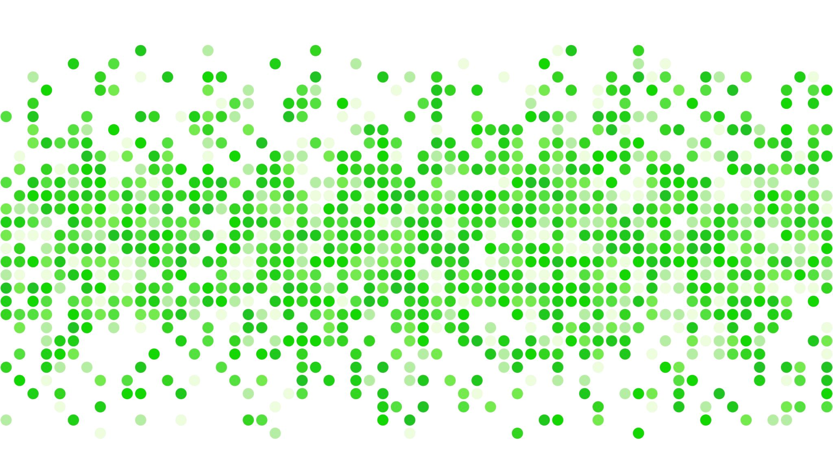
Conclusion

Slide 23
An Opportunity for Immense Growth
In conclusion, the urgency for sustainable and efficient energy solutions has never been more palpable, underscored by the global push for greener technologies. While areas like Africa remain significantly under-energized, developed regions are also in a race against time to phase out fossil fuels. Nuclear energy, with its advancements in safety and efficiency, stands out as a highly viable solution to meet these escalating demands. This analysis, grounded in concrete data, suggests that strategic investments in nuclear technology in the U.S. would not only meet the daily energy consumption of its populous metro areas but also serve as a model for clean and sustainable energy globally.
By applying meticulous site selection criteria—from size and accessibility to seismic stability and security, I have identified key locations for future nuclear installations. These range from entirely new sites to the refurbishment of existing, decommissioned facilities, each offering a unique set of advantages and challenges.
As we look ahead, these findings arm us with the insights needed to make informed decisions, ensuring that we are not just reacting to the energy needs of today but are well-prepared for the demands of tomorrow.

Slide 24
Appendix
Github link to project repository
Data Sources
- Kaggle
- Cristianst85
- Population Data 1
- Population Data 2
- Population Data 3
- Energy Data

